Slide 1
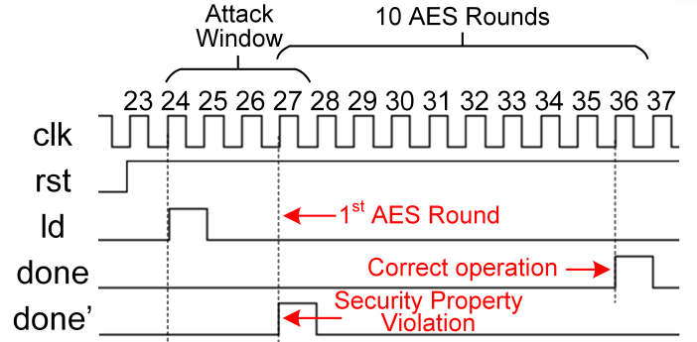
1. Simulation (VCS)
Security property example: The done signal that indicates the completion of 10 AES rounds cannot be raised in the 1st AES round.
However, when executing:
Which cycle is the 1st AES round?
What cycles should we inject faults?
Get the information from no-fault waveform
Files to prepare
Design netlist, testbenches, library file, VCS commands

Slide 2
2. Fault (ZOIX) Simulation
Files to modify
RTL or gate-level netlist (in the “designs” folder)
Testbench (input.vcd): stimulus signals dumped from running functional simulation (without fault). E.g., add an initial block in your testbench for dumping your interested signals, then run VCS
Security properties (strobe.sv): See the following slide
Fault list (user.sff): run sff_gen.py to generate the fault list
File source definition (run.f)
Files to prepare without modifying
ZOIX Fault Manager configuration (user.fmsh)
Commands for run (run.sh) and clean.sh
To run, execute: sh run.sh

Slide 3
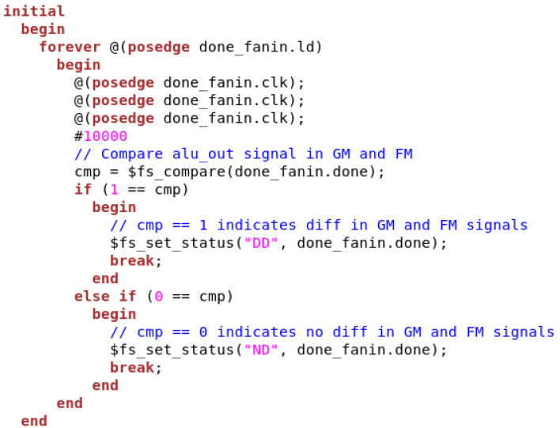
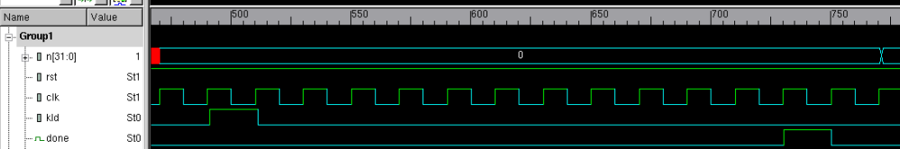
2. Fault (ZOIX) Simulation – SP Definition
Security Property (SP)
Are checked in the fault simulation using strobe file
Strobe File
Written in System Verilog
When, Where, and What to check for security property violation
If diff in Good Machine (GM) and Faulty Machine (FM), SP violation
When: 3 clock cycles after ‘load’ is raised
Where: at signal ‘done’
What: compare the signals
in GM and FM
Strobe Here
0 1 2 3 4 5 6 7 8 9 10 11 12
Notes:
Strobe file contains all the definitions of executable security properties needed by SoFI.
GM: good machine
FM: faulty machine

Slide 4
3. Verify the Injected Fault
Files to prepare:
Faulty waveform (e.g., ff.fm1.vcd): If “./zoix.sim -fault +fault+machine+1 +vcd+file+input.vcd” in run.csh file is executed, you can get a vcd file with fault-machine's number in its name (e.g., simulation inserted with the 1st fault in your fault list will be dumped into ff.fm1.vcd)
To view the faulty waveform, use dve& command and open the .vcd file
This will help verify if you are injecting faults as intended
Format bugs need to be fixed in the dumped .vcd file because of ZOIX internal bugs.
To fix the bug in dumped ff.fm1.vcd, find $dumpvars, add a "#0" above it, and delete all the signal changes (instead of signal definitions) before "endscope".
To make it easier, compare the correct vcd format of input.vcd.

